Slide 1
Exercise session #2
Science of
Climate Change
Sept. 19, 2024

Slide 2
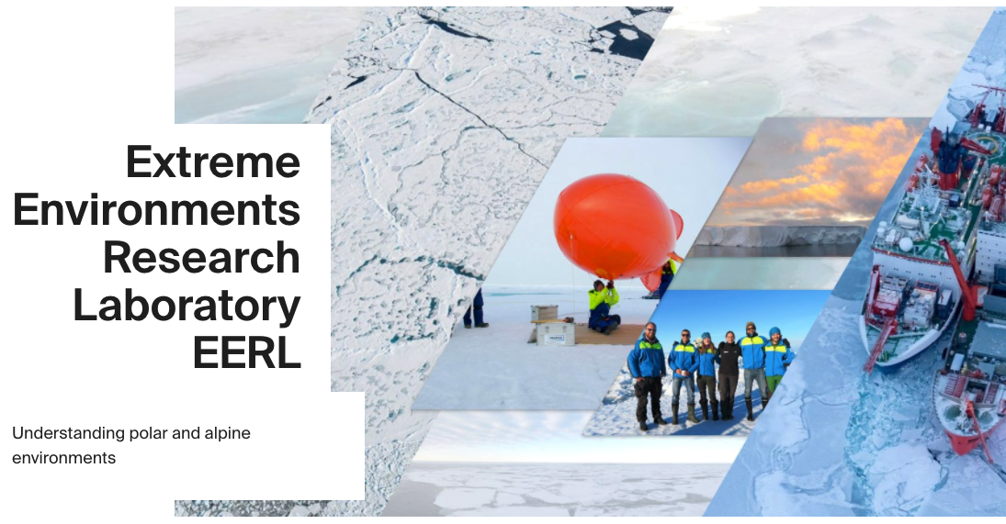
Mihnea Surdu Teaching Assistant
MSc in Chemistry, University of Edinburgh
PhD in Atmospheric Chemistry, Paul Scherrer Institute / ETH Zurich
Scientific Collaborator at EPFL’s Extreme Environments Research Lab (Sion, Valais) since September 2023
https://www.epfl.ch/labs/eerl/
Will be TA for the next 3 classes

Slide 3
Today’s goal:
Understanding Radiation
Recap lapse rate, sensible and latent heat

Slide 4
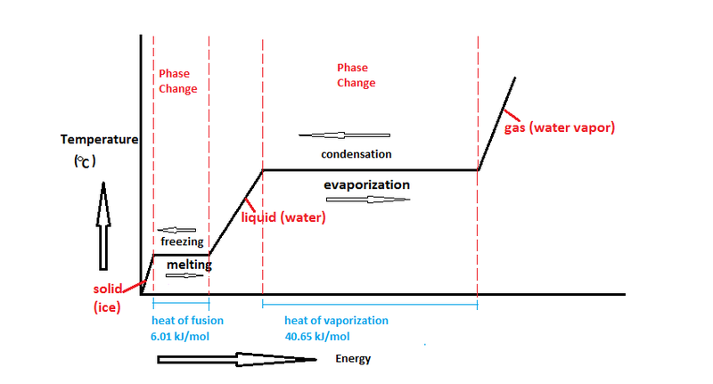
Recap: Latent and sensible heat
Both processes transfer energy in the climate system.
Latent heat: energy transferred in a process without change of the body's temperature, it is associated with the change of phase of atmospheric or ocean water: vaporization, condensation, freezing or melting.
Sensible heat: ″sensed″ or felt in a process as a change in the body's temperature, e.g., as increasing or decreasing air or water temperature.
sensible
sensible
https://commons.wikimedia.org/wiki/File:Water_Phase_Change_Diagram.png
latent
latent
Remember cloud formation through condensation!
Also applies to fluxes from land!

Slide 5
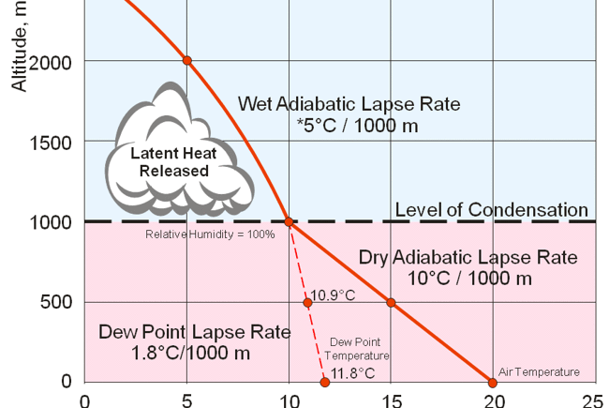


Recap: Lapse Rate
Dew point temperature: temperature of air at which it will become saturated with water vapor (RH = 100%)
Environmental lapse rate $Γ$is the rate at which temperature (T) decreases with height (z), it is roughly 6.5 degrees per 1000 m.
$Γ=−\frac{dT}{dz}$ (K/m)
Because condensation is involved, we speak of the wet (moist) adiabitic lapse rate. Air parcels cool because heat is released as condensation heat.
Air becomes saturated with water vapor and clouds can form through condensation (a process of latent heat release).
Pockets of warmer air rise, expand and cool and the cooler air compresses and falls until it is in equilibrium with the surrounding air. There is no condensation involved, hence dry adiabatic lapse rate.
Adiabatic means, there is no heat or mass transfer between the air parcel and environment, only work is done (expansion).
Notes:
(From Charlie’s weather)

Slide 6
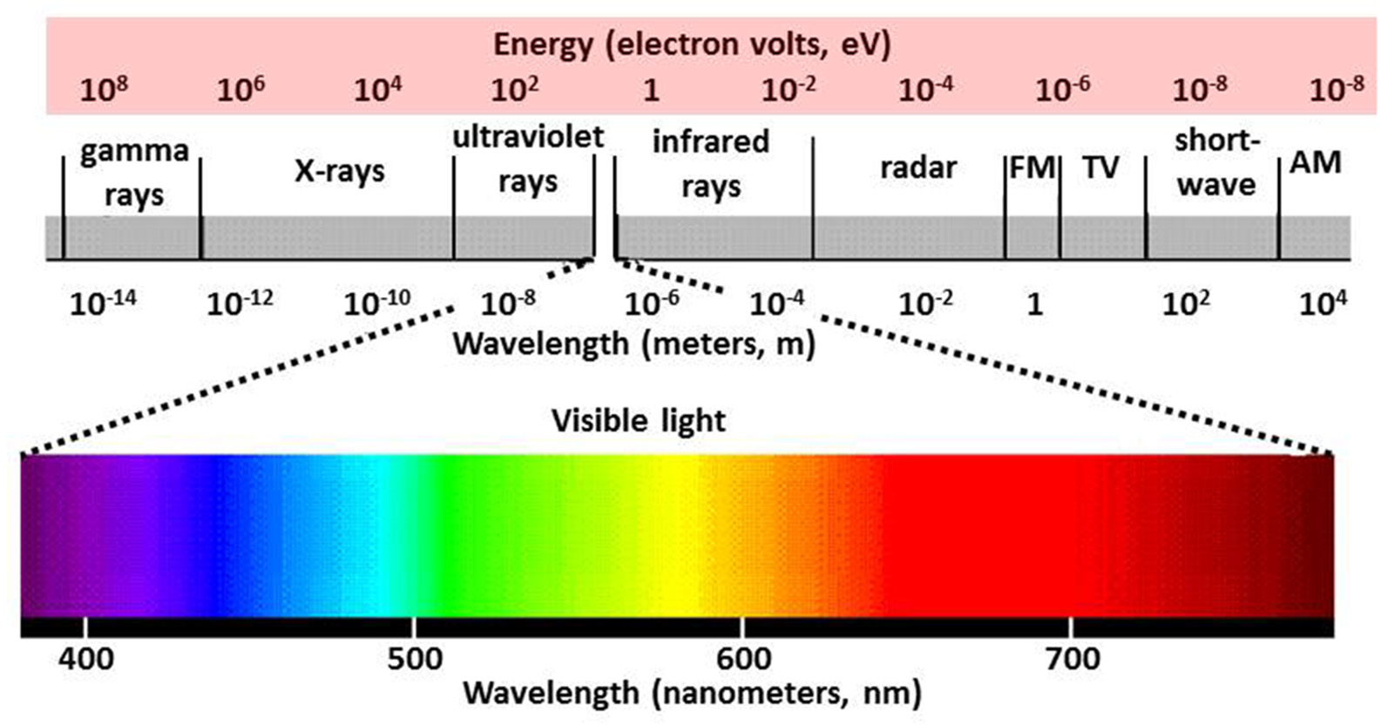
Electromagnetic Radiation

Slide 7
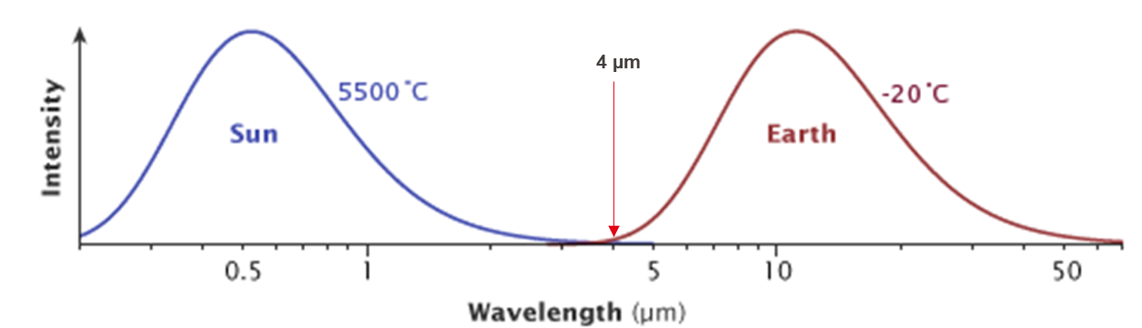
Recap: solar and terrestrial radiation
Question: why do the sun and earth emit at different wavelengths?
Different temperature
Shortwave, Solar, Downwelling
Longwave, Terrestrial, Upwelling
cf. Figure 4.7, Wallace and Hobbs, 2006
Notes:
Curves are normalized not the same intensity of earth and sun
Normally shown on logarithmic axes because of the wide range covered.
Sun and Earth emit radiation in different wavelengths, UV and IR spectrum
Shortwave and longwave

Slide 8
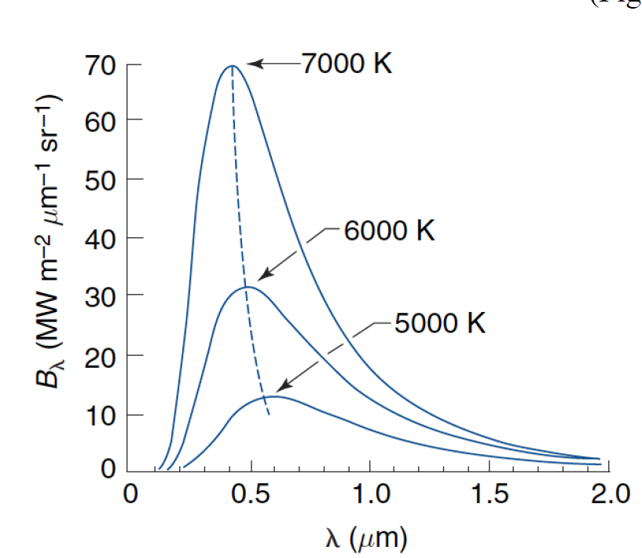
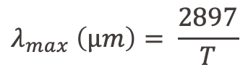
Recap from lecture
Blackbody radiation (Planck function)
The Planck function states that the emission intensity of a blackbody depends on the body’s temperature and the wavelength considered
Wien’s displacement law gives relationship between temperature of a body and its emission spectrum
$$λ_{max} \left(µm\right)= \frac{2897}{T}$$
Emission spectra of a blackbody at three different temperatures

Slide 9

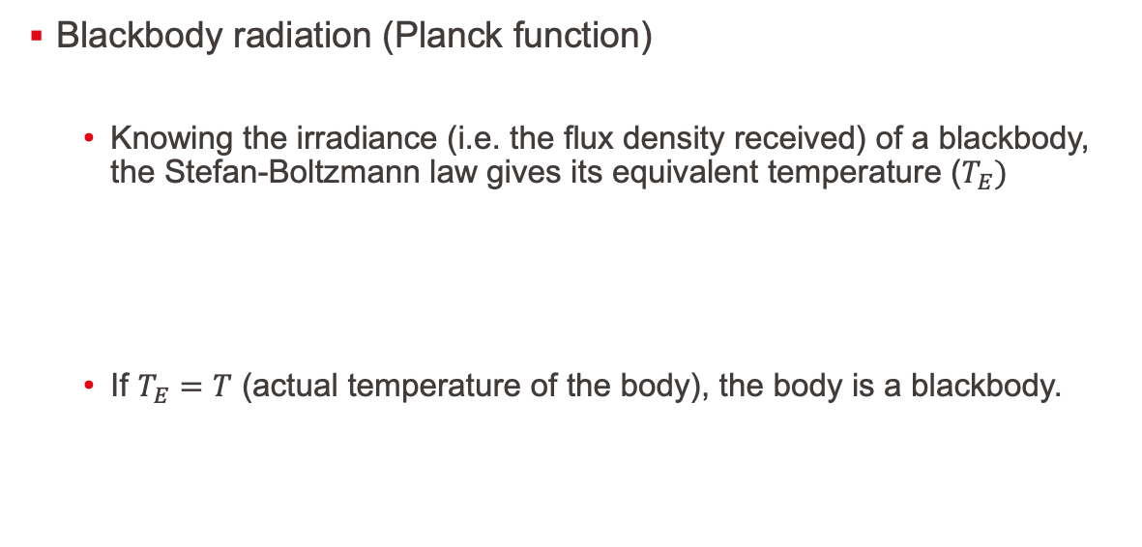
Recap from lecture
Blackbody radiation (Planck function)
Knowing the irradiance (i.e. the flux density received) of a blackbody, the Stefan-Boltzmann law gives its equivalent temperature ($T_{E})$
If $T_{E}=T$ (actual temperature of the body), the body is a blackbody.
$F$ = $σT_{E}^{4}$
$σ$ = 5.67 × 10⁻⁸ W m⁻² K⁻⁴ Stefan Boltzmann constant

Slide 10
Exercises

Slide 11
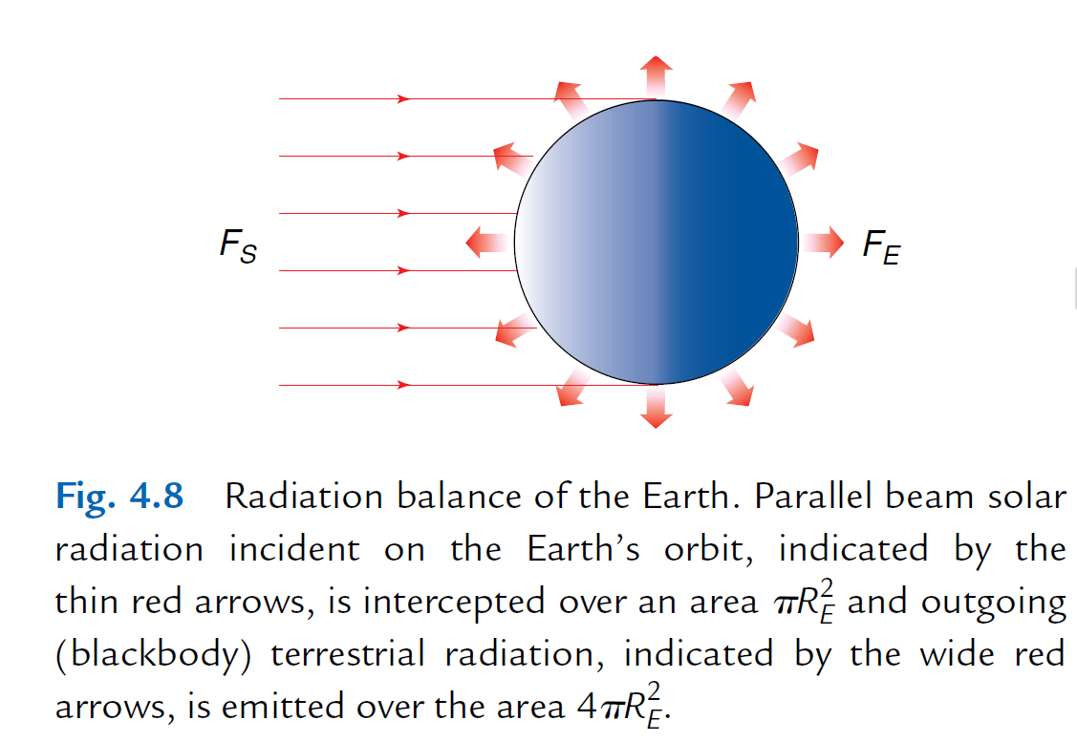
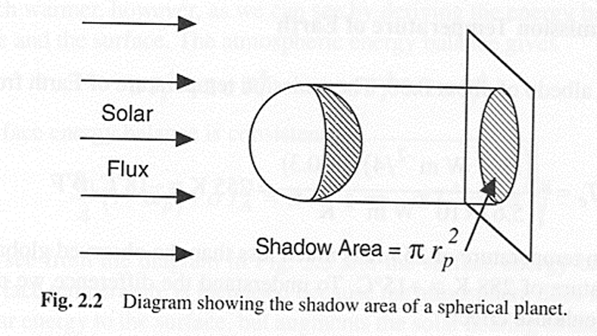

Exercise question 1
Assuming radiative equilibrium, i.e., Earth does not gain nor lose energy, calculate the equivalent temperature of Earth.
Solar constant: $S_{0}=1370 W/m^{2}$
Hints:
radiative equilibrium
Area of a sphere = 4·π·R²
Earth’s planetary albedo = 0.3

Slide 12

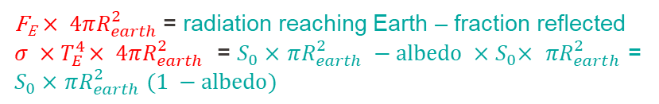
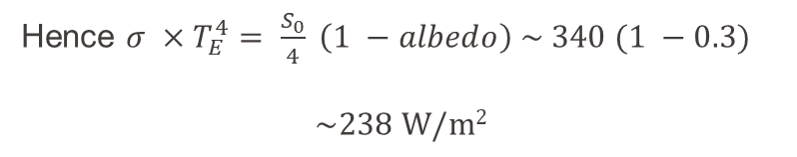


Q1 - Solution
In equilbrium, Energy emitted by Earth = Energy absorbed by Earth
Stefan-Boltzmann law
$F$ = $σT_{E}^{4}$
F_{E} $× 4πR_{earth}^{2}$ = radiation reaching Earth – fraction reflected $σ ×{ T}_{E }^{4}× 4πR_{earth}^{2}$ = $S_{0}×$ $πR_{earth}^{2} −albedo ×{ S}_{0}× πR_{earth}^{2}$ =
$S_{0}×$ $πR_{earth}^{2} (1 −albedo)$
$σ$ = 5.67 × 10⁻⁸ W m⁻² K⁻⁴
Stefan Boltzmann constant
Hence $σ ×{ T}_{E }^{4} = \frac{S_{0}}{4} \left(1 −albedo\right) \sim 340 (1 −0.3)$
$$\sim 238 W/m2$$
Planetary albedo
See next slide
$$T_{E}= \sqrt[4]{\frac{238}{5.67 × {10}^{−8}}}=255 K=−18℃$$

Slide 13
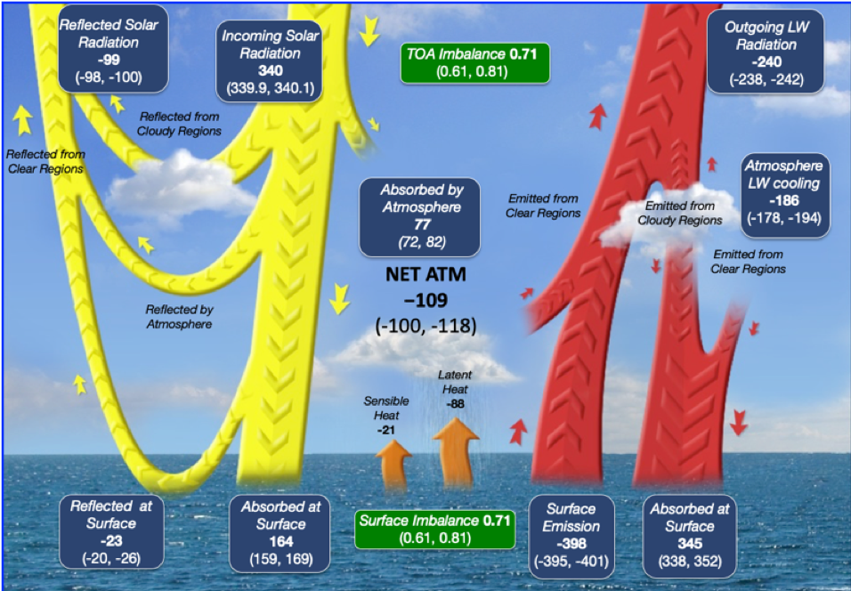
Q1 – Solution
The Earth receives a total amount of radiation determined by its cross section (π·R_{E}²)
But as it rotates this energy is distributed across the entire surface area (4·π·R_{E}²).

Slide 14
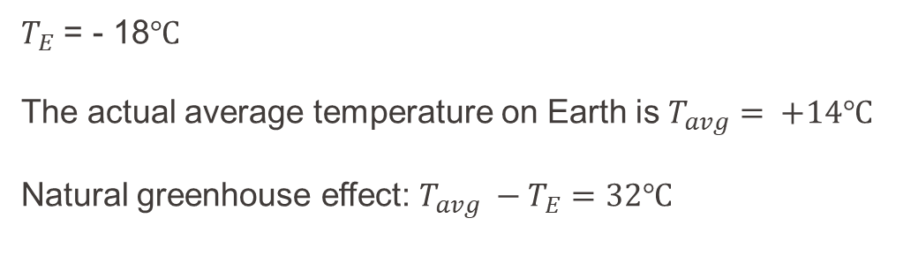
Q1– Solution
$T_{E}$ = - 18$℃$
The actual average temperature on Earth is $T_{avg}= +14℃$
Natural greenhouse effect: $T_{avg} −T_{E}=32℃$

Slide 15
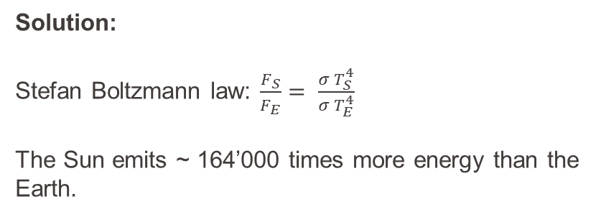

Exercise 2
2. The Sun is much warmer than the Earth. The Earth has a surface temperature of $288 K$ while the Sun’s temperature is $T_{S}=5800 K$. How much more energy per square meter does it emit?
Solution:
Stefan Boltzmann law: $\frac{F_{S}}{F_{E}}= \frac{σ T_{S}^{4}}{σ T_{E}^{4}}$
The Sun emits ~ 164’000 times more energy than the Earth.
Normalized for comparison

Slide 16
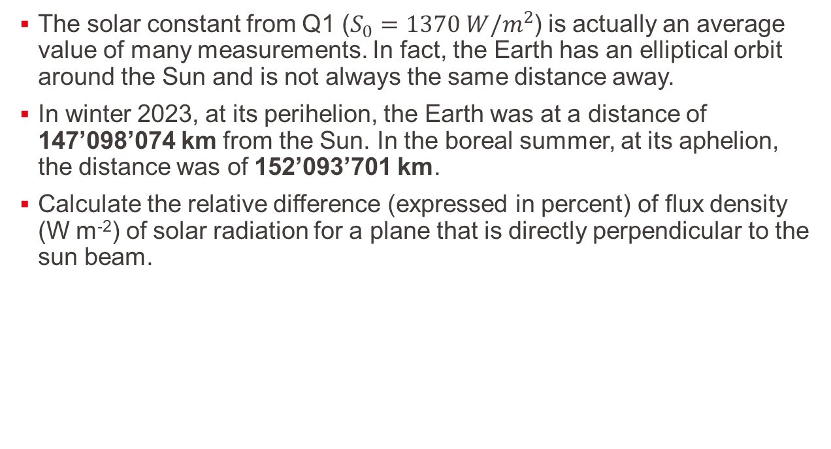
Exercise 3
The solar constant from Q1 ($S_{0}=1370 W/m^{2}$) is actually an average value of many measurements. In fact, the Earth has an elliptical orbit around the Sun and is not always the same distance away.
In winter 2023, at its perihelion, the Earth was at a distance of 147’098’074 km from the Sun. In the boreal summer, at its aphelion, the distance was of 152’093’701 km.
Calculate the relative difference (expressed in percent) of flux density (W m⁻²) of solar radiation for a plane that is directly perpendicular to the sun beam.

Slide 17
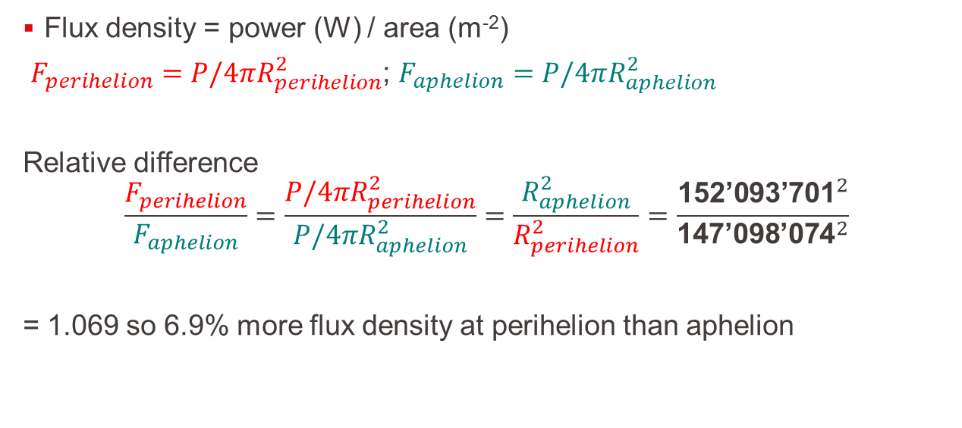
Exercise 3 - solution
Flux density = power (W) / area (m⁻²)
$F_{perihelion}=P/4πR_{perihelion}^{2}$; $F_{aphelion}=P/4πR_{aphelion}^{2}$
Relative difference
$$\frac{F_{perihelion}}{F_{aphelion}}=\frac{P/4πR_{perihelion}^{2}}{P/4πR_{aphelion}^{2}}=\frac{R_{aphelion}^{2}}{R_{perihelion}^{2}}=\frac{{\text{152’093’701}}^{2}}{{\text{147’098’074}}^{2}}$$
= 1.069 so 6.9% more flux density at perihelion than aphelion

Slide 18
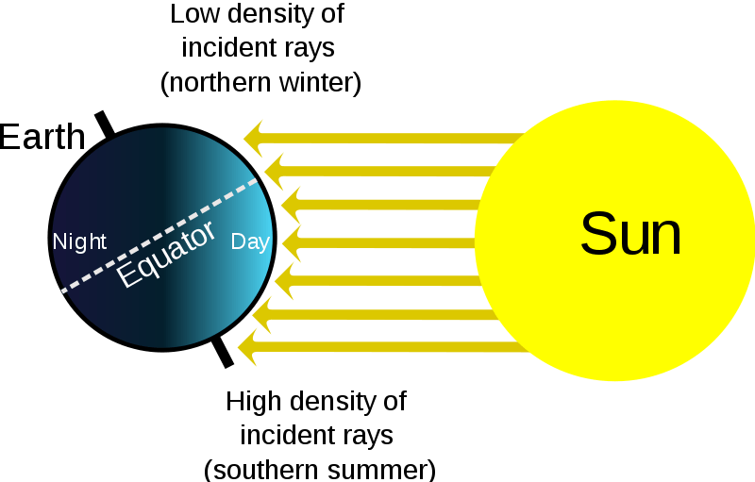
Is this why we have seasons?
No
It has to do with the tilt of the Earth
Actually the Earth is closer to the Sun in boreal (northern hemisphere) winter..

